Slide 1
Electronics 101

Slide 2
DISCLAIMER
At first, we will look at a very small subset of electrical engineering
Specifically, for the time being, we’re focusing on steady-state circuits
That is, everything stays the same over time; there are no pulses, for example, or sine waves, or signals
A lot of the things that I will say are wrong in the general sense
For example, “electricity can’t pass through an insulator”
Understand that these things are simplifications that make electronics easier to understand under specific circumstances, but are not always true
I’ll make it clear when I’m saying something that is a real, no-shit physical law

Slide 3
The “Water Analogy”
Often, I’ll compare electrical processes and components to flowing water, pipes, etc.
Again, these are approximations that are intended to help give an intuitive understanding of electricity, but that shouldn’t be taken too far

Slide 4
Electrical Charge
Electrical charge is a measure of the “amount of electricity”
The SI unit of electrical charge is the coulomb
Unlike mass (as far as we know), charge is not absolute; it can be positive or negative
This is not a transient or relative property; you can absolutely just cram some coulombs into an object
This is basically what happens when you shuffle your feet on a carpet in dry weather

Slide 5
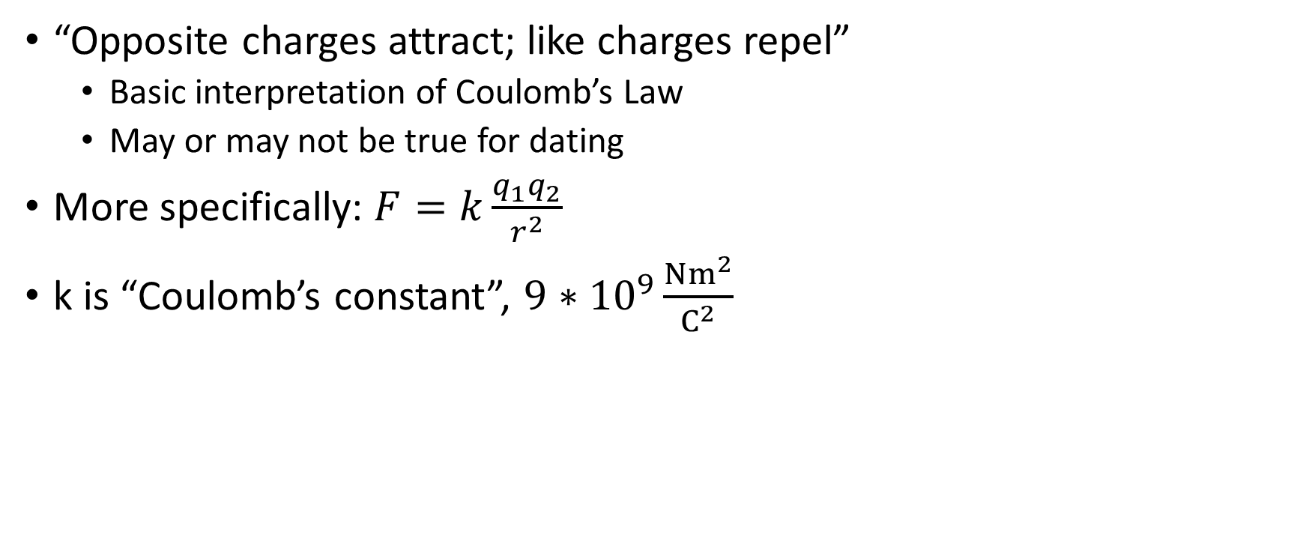
Electrical Charge
“Opposite charges attract; like charges repel”
Basic interpretation of Coulomb’s Law
May or may not be true for dating
More specifically: $F=k\frac{q_{1}q_{2}}{r^{2}}$
k is “Coulomb’s constant”, $9∗{10}^{9}\frac{Nm^{2}}{C^{2}}$

Slide 6
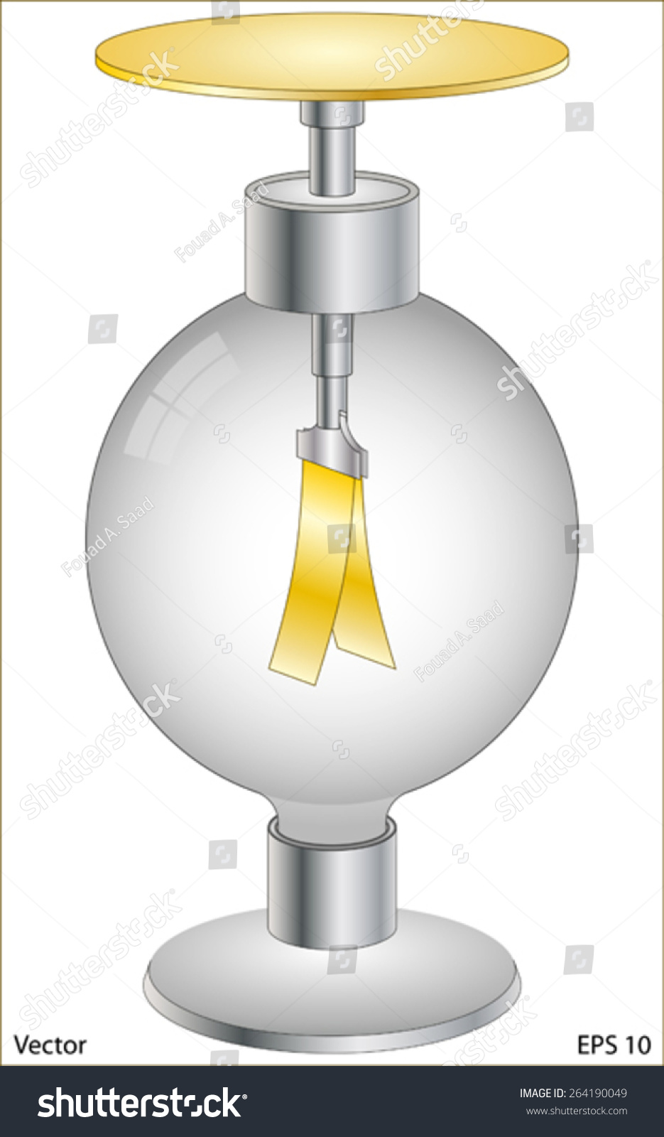
Electrical Charge
This leads directly to the concept of the “electrometer”

Slide 7
Current
Any charge (positive or negative) is conveyed by charge carriers
Frequently, this implies electrons
Electrons have negative charge
Specifically, one electron carries -1.602 × 10⁻¹⁹ C
Positive charge is often modeled as places that an electron could be, but isn’t
These places are called holes
E.g., if a BB has room for one more electron than it actually has, then it has one hole, or 1.602 × 10⁻¹⁹ C (positive charge)

Slide 8
Current
The amount of charge passing a certain point in a certain amount of time
Measured in amperes
Usually abbreviated amps
1 ampere = 1 coulomb per second

